Slide 1

Welcome to Year 1
With Mrs MacDonald (and Mrs Doe)

Slide 2
Year 1
Transition year between Early Years Foundation Stage and formal learning of KS1
Enhanced provision – giving more challenge
In the summer term beginning to focus on year 2 readiness
Statutory assessment – Phonics screening check – June 2027.

Slide 3
Phonics
Key focus for KS1
Daily session – 30 minutes
Children are assessed and grouped according to the level they are working at.
Reading books contain the sounds the children have learnt already.
Phonics screening check – June 2027 (plus practice checks throughout the year)

Slide 4
English Expectations
Reading
Comprehension
Spelling
Writing

Slide 5
Reading
Huge priority in KS1
Books are based on phonics assessed secure level.
Reading books are to be in school every day.
Every child will read to an adult 3x a week
Reading for pleasure at home and in school.
Aim to read at least 4 times a week at home.
Record in Reading Record (new plan for this)

Slide 6
Reading Expectations
I can read accurately most words of two or more syllables.
I can read most words containing common suffixes.
I can read most common exception words.
I can read words accurately and fluently without overt sounding and blending i.e. at over 90 words per minute.
I can sound out most unfamiliar words accurately, without undue hesitation.
I can check that what I read makes sense.
I can answer questions and make some inferences on the basis of what is being said and done.
I can explain what has happened so far in what I have read.

Slide 7
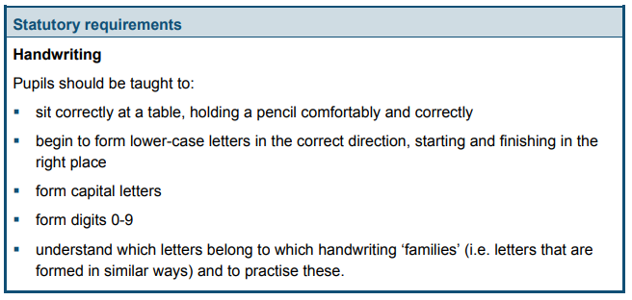
Writing Expectations

Slide 8
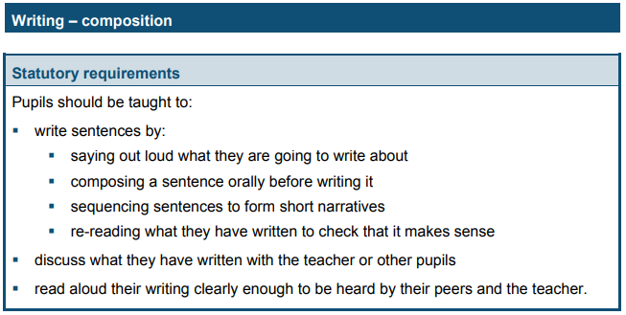
Writing Expectations

Slide 9
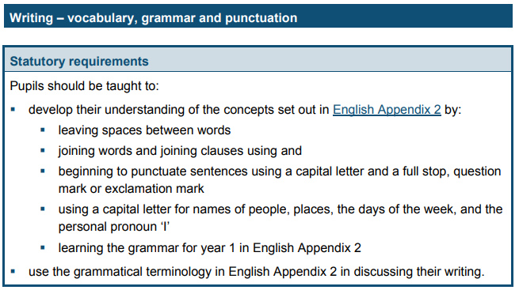
Writing Expectations

Slide 10
Spellings Expectations
Pupils should be taught to:
spell:
  words containing each of the 40+ phonemes already taught
  common exception words
  the days of the week
name the letters of the alphabet:
naming the letters of the alphabet in order
  using letter names to distinguish between alternative spellings of the same sound
add prefixes and suffixes
write from memory simple sentences dictated by the teacher that include words using the GPCs and common exception words taught so far
Notes:
Explain the spelling process and why it is important for children to learn spellings. Link to SPAG test in Year 6.

Slide 11
Maths Expectations
Count forwards and backwards to 100, read and write these, say one more and one less
Count in twos, fives and tens
Read and write number words to 20
Add and subtract with numbers to 20, including missing number problems (_ + 2 = 7)
Multiply and divide using objects to help
Understand half and a quarter of shapes, numbers and objects
Compare length, height, mass, capacity, volume and time
Measure length, height, mass, capacity, volume and time
Recognise coins and notes
Tell the time to the hour and half past
Understand days, weeks, months and years
Sequence events using vocabulary such as morning, afternoon, yesterday, tomorrow etc.
Recognise and name 2D and 3D shapes
Describe position, direction and movement including using turns

Slide 12
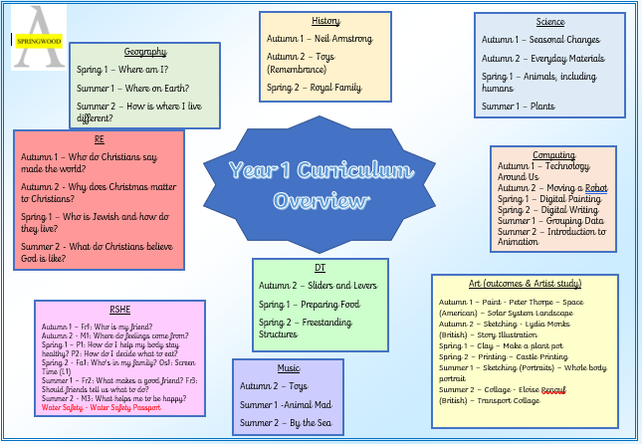
Wider Curriculum

Slide 13
Attendance
Extremely important your child is at school everyday.
Ring school on everyday of absence.
90% attendance = ½ a day missed each week
Monitor any attendance falling below 96%
Punctual – 8.40 – 8.45 am school day starts
Day ends at 3:15
Notes:
Can explain that you will receive letters and be asked to come into school to discuss your child’s attendance, if it falls below 96%

Slide 14
Extra Information
Breakfast available in class during morning break.
PE days – to be confirmed in September

Slide 15
What can you do to help?
Connect to Class Dojo
Complete all homework – reading, phonics, spelling, maths skills
Ensure correct equipment is in school everyday – reading record, water bottle, full PE kit can be left over the half term.
Ensure your child arrives on time everyday and attends regularly.
Ensure your child is in complete uniform.

Slide 16
Educational Visits
Trips – out of school and visitors into school
In the works!
Library visit - December
History – Conisbrough Castle?
Geography local trip
Notes:
Explain the process of text messaging.

Slide 17

Any questions?

